Slide 1


Consumer Goods Ad_Hoc Insights
Codebasics Resume Project Challenge 4
Presented By : Kiran Kumar

Slide 2
Problem Statement
AtliQ Hardware's ( an imaginary company) is one of the leading computer hardware producers in India and well expanded in other countries as well.
However, the management noticed that they do not get enough insights to make quick and smart data-informed decisions. They want to expand their data analytics team by adding several junior data analysts.
Tony Sharma, their data analytics director wanted to hire someone who is good at both tech and soft skills. Hence, he decided to conduct a SQL challenge which will help him understand both the skills.
Presented By : Kiran Kumar

Slide 3
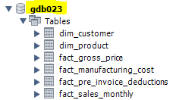
About the Project
For our project, we will be working with a dataset that contains nearly 1 million records. Our prime focus will be on answering all ad-hoc requests using SQL queries.
Database : gdb023
Fact Tables
Dimension Tables
fact_gross_price
dim_product
fact_sales_monthly
dim_customer
fact_pre_invoice_deductions
fact_manufacturing_cost
Presented By : Kiran Kumar

Slide 4
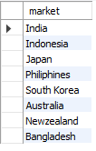

Ad_Hoc Request - 1
Question 1:
Provide the list of markets in which customer "AtliQ Exclusive" operates its business in the APAC region.
Output
SQL Query
Presented By : Kiran Kumar

Slide 5
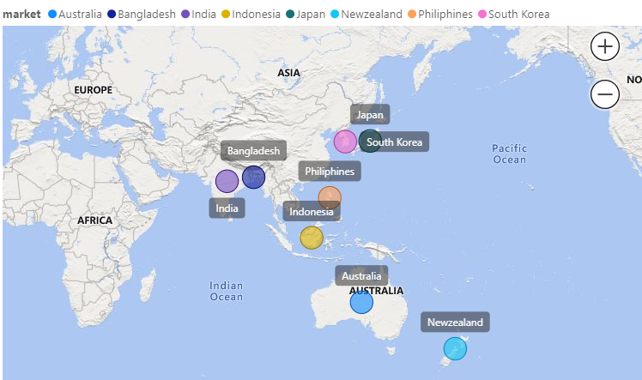
Query – 1 Visualization
Insights
AtliQ Exclusive has a wide presence in the APAC region which includes countries such as India, Indonesia, Bangladesh, Australia, Japan, New Zealand, Philippines and South Korea.
This expansive footprint underscores AtliQ Exclusive's strategic positioning and potential for growth within the diverse and dynamic APAC market.
Presented By : Kiran Kumar

Slide 6
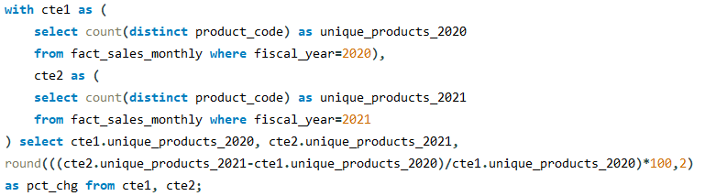

Ad_Hoc Request - 2
Question 2:
What is the percentage of unique product increase in 2021 vs. 2020?
The final output contains these fields, unique_products_2020, unique_products_2021 and percentage_chg.
Output
SQL Query
Presented By : Kiran Kumar

Slide 7
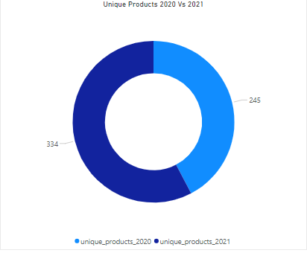
Query – 2 Visualization
Insights
We can clearly see that there is a increase in the unique product count from FY 2020 to FY 2021.
There is a increase of almost 36.33 % in unique product count which is a good sign for AtliQ Hardware.
The rise in unique product count signifies AtliQ Hardware's commitment to diversifying its product portfolio.
This growth can translate into increased brand visibility, customer loyalty, and market share for the company.
Presented By : Kiran Kumar

Slide 8
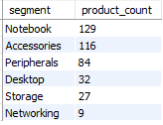

Ad_Hoc Request - 3
Question 3:
Provide a report with all the unique product counts for each segment and sort them in descending order of product counts.
The final output contains 2 fields, segment and product_count.
SQL Query
Output
Presented By : Kiran Kumar

Slide 9
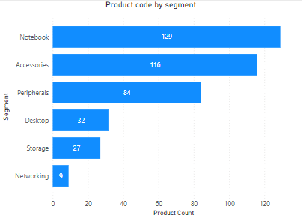
Query – 3 Visualization
Insights
“Notebook” segment has the highest product count with 129 products.
﻿At 129, Notebook was 1,333.33% higher than Networking, which had the lowest count of product at 9.
By understanding how each segment contributes to the overall business, AtliQ Hardware can make informed decisions regarding resource allocation and strategic planning.
Presented By : Kiran Kumar

Slide 10
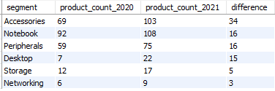
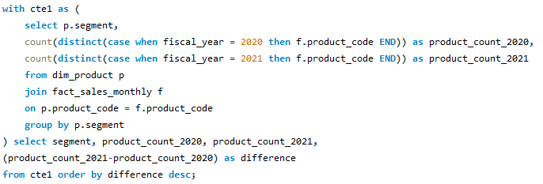
Ad_Hoc Request - 4
Question 4:
Follow-up: Which segment had the most increase in unique products in 2021 vs 2020?
The final output contains these fields, segment, product_count_2020, product_count_2021 and difference.
SQL Query
Output
Presented By : Kiran Kumar

Slide 11
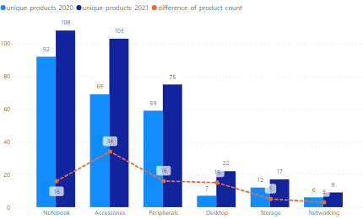
Query – 4 Visualization
Insights
The "Accessories" category witnessed a significant increase in product count, with 34 more products added compared to FY 2020.
﻿﻿In FY 2020, the "Notebook" category had the highest number of unique products at 92, marking a 1,433.33% increase over "Networking," which had the lowest unique products at 6.
Overall, there was a consistent trend of increasing product diversity across various categories.
Presented By : Kiran Kumar

Slide 12
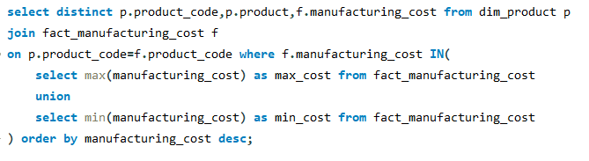

Ad_Hoc Request - 5
Question 5:
Get the products that have the highest and lowest manufacturing costs. The final output should contain these fields, product_code, product and the manufacturing_cost.
SQL Query
Output
Presented By : Kiran Kumar

Slide 13
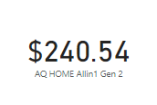
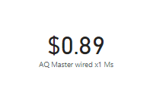
Query – 5 Visualization
Product with highest manufacturing cost
Insights
The product “AQ HOME Allin1 Gen 2” has the maximum manufacturing cost with around $240.54.
While the product “AQ Master wired x1 Ms” has the minimum manufacturing cost with around $0.89.
Identifying products with high manufacturing costs, such as "AQ HOME Allin1 Gen 2" with $240.54, presents an opportunity for cost optimization initiatives. This could involve reassessing material sourcing, production processes, or supplier relationships to reduce expenses and improve profitability.
Product with lowest manufacturing cost
Presented By : Kiran Kumar

Slide 14
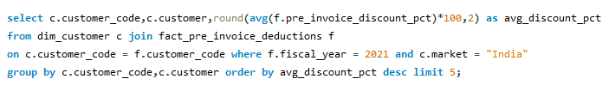
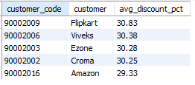
Ad_Hoc Request - 6
Question 6:
Generate a report which contains the top 5 customers who received an average high pre_invoice_discount_pct for the fiscal year 2021 and in the Indian market. The final output contains these fields, customer_code, customer and average_discount_percentage.
SQL Query
Output
Presented By : Kiran Kumar

Slide 15
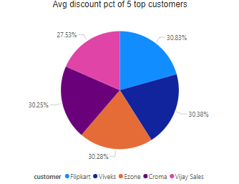
Query – 6 Visualization
Insights
“Flipkart” has the highest average pre- invoice discount with 30.83 %.
﻿While “Vijay Sales” has comparatively lower average discount percentage at 27.53%.
This suggests that Flipkart may employ a competitive pricing strategy to attract customers by offering significant discounts on a wide range of products.
Presented By : Kiran Kumar

Slide 16
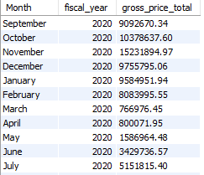
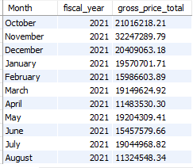
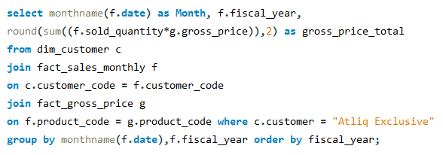
Ad_Hoc Request - 7
Question 7:
Get the complete report of the Gross sales amount for the customer “AtliQ Exclusive” for each month . This analysis helps to get an idea of low and high-performing months and take strategic decisions.
The final report contains these columns: Month, Year and Gross sales Amount.
SQL Query
Output
Presented By : Kiran Kumar

Slide 17
Query – 7 Visualization
Insights
AtliQ Hardware witnessed approximately $32 million in FY 2021, specifically in the month of November, which marked the highest figure. Approximately $15 million was achieved in FY 2020 in the month of November.
﻿There is a steep decrease in gross sales in the months of March and April in both financial years.
Identifying areas where operational processes can be optimized can lead to cost savings and enhanced competitiveness in the market.
Presented By : Kiran Kumar

Slide 18
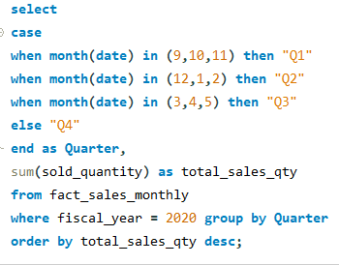

Ad_Hoc Request - 8
Question 8:
In which quarter of 2020, got the maximum total_sold_quantity?
The final output contains these fields sorted by the total_sold_quantity, Quarter and total_sold_quantity.
SQL Query
Output
Presented By : Kiran Kumar

Slide 19
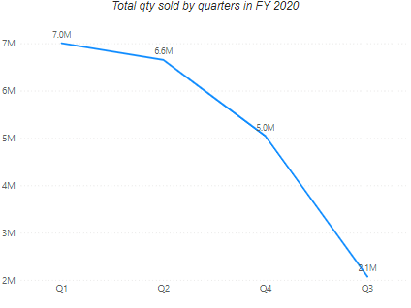
Query – 8 Visualization
Insights
The maximum total quantity sold in fiscal year 2020 is in Quarter 1 with 7 million and the minimum quantity sold was in Quarter 3 with 2 millions.
﻿While Quarter 3 historically registers the lowest sales volume, it presents an opportunity for strategic intervention to bolster performance.
This also suggests a degree of volatility in sales performance, with potential factors such as seasonal fluctuations, market dynamics, or internal operational factors.
Presented By : Kiran Kumar

Slide 20
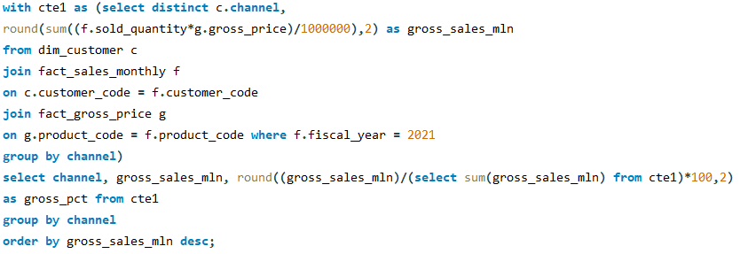

Ad_Hoc Request - 9
Question 9:
Which channel helped to bring more gross sales in the fiscal year 2021 and the percentage of contribution?
The final output contains these fields, channel, gross_sales_mln and percentage.
SQL Query
Output
Presented By : Kiran Kumar

Slide 21
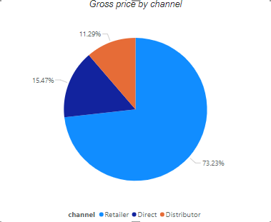
Query – 9 Visualization
Insights
The ”Retailer” channel has accounted for the majority of the sales occupying almost 73% of gross sales.
﻿While the direct and distributor channel is occupying 15% and 11% of gross sales respectively.
These insight enables businesses to optimize resource allocation, prioritize high-profit channels, and potentially reallocate resources from less profitable channels to maximize overall profitability.
Presented By : Kiran Kumar

Slide 22
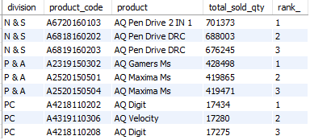
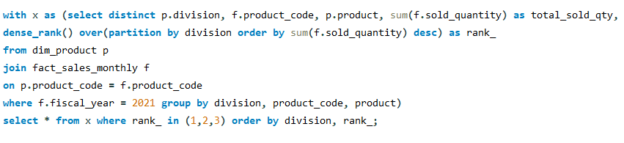
Ad_Hoc Request - 10
Question 10:
Get the Top 3 products in each division that have a high total_sold_quantity in the fiscal_year 2021?
The final output contains these fields, division, product_code, product, total_sold_quantity and rank_order.
SQL Query
Output
Presented By : Kiran Kumar

Slide 23
Query – 10 Visualization
Insights
AQ Pen Drive 2 in 1 (in N&S division)emerged as the best-selling item, followed by AQ Gamers Ms (in P&A division) and AQ Digit in (PC division).
These products exhibit strong market demand and should be further analyzed for potential growth opportunities.
Our efforts should focus on enhancing these products' value propositions to better align with consumer needs and preferences.
Presented By : Kiran Kumar

Slide 24

Presented By : Kiran Kumar

